Slide 1
Revision Record
Don’t Print This Page
Course Code
Product
Product Version
Course Version Issue
Domain
Huawei CTI
ICDV300R005C45
eSpace CC ISV V100R001C01LINH04
Developer / Modifier
Date
Approver
New / Update
< Name of Author >
< YYYYMMDD >
< Name of Approver >
New

Slide 2
CTI Installation and Upgradation [Linux OS]

Slide 3

Agenda
Huawei IPCC Network Architecture Introduction
CTI Platform Overview
WAS Overview
MainAst Tool Overview, Installation and Configuration
CTI Platform and WAS Installation in Linux OS
CTI Upgradation
References

Slide 4
Objectives
Upon completion of this course, you will be able to:
Know how to install Huawei TopENG CTI platform on a Linux OS

Slide 5

Target Audience
This course has been designed for the audience who are undergoing training on Huawei IPCC solution. This course will make familiar the audience on the installation of the CTI platform and its components. in Linux OS

Slide 6
Training Pre Requisites
Undergone training on Huawei IPCC
Solution Introduction
Undergone training on Basic Understanding of CTI Platform
and its components.
Basic Knowledge of UAP
Web Application Server Overview
Basic knowledge and Commands of Linux OS

Slide 7
Installation Pre Requisites
IP Address Planning
Network Planning
Operating system planning and availability
Hardware Planning
Apply for Licenses
Database Version and Planning
Notes:
Oracle DB Versions :
􀁺 Oracle9.2.0.8
􀁺 Oracle10.1.0.3
􀁺 Oracle11.1.0.7
SQL Server :
SQL Server2000 8.00.760
􀁺 SQL Server2005
􀁺 SQL Server2008

Slide 8
Agenda
Huawei IPCC Network Architecture Introduction
CTI Platform Overview
WAS Overview
MainAst Tool Overview, Installation and Configuration
CTI Platform and WAS Installation in Linux OS
CTI Upgradation
References

Slide 9

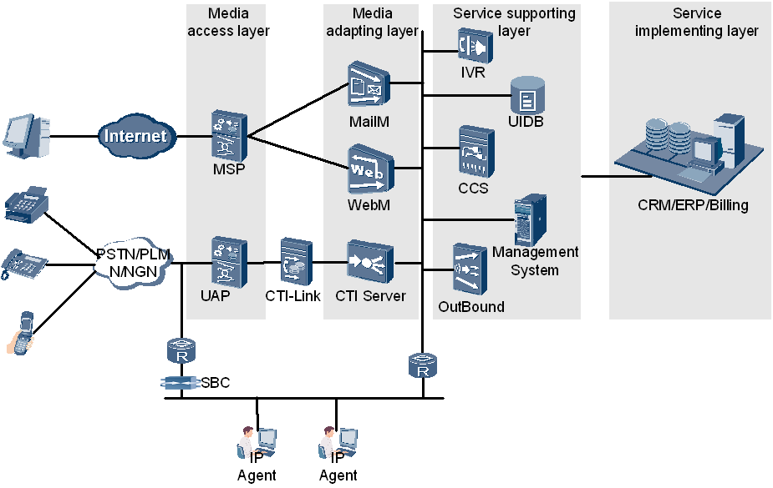
Huawei IPCC Network Architecture
Notes:
MSP: The media sender platform (MSP) is a system that processes, sends, and receives multimedia messages. The multimedia messages include MMS,SMs, WAP Push messages,Faxes, Emails.
UAP: The UAP provides the functions of the special narrowband resources required by the public switched telephony network (PSTN) or public land mobile network (PLMN), in addition to the functions of the broadband media resources required by the next generation network (NGN) or third generation (3G)
Media Access Layer
This layer supports the access of multiple media, such as voice, fax, VoIP, Web and email
Media Adapting Layer
This layer is used to process the accessed calls of various media. It processes calls of various media such as speech calls, E-mail calls and Web calls to unified calls so that various media can
communicate with the service supporting layer no matter what types the media are.
Service Supporting Layer
This layer is used to resolve, create and control the services. It is correlated with the media access
layer and provides component resources for realizing specific services. The equipment or
modules related to specific services can be constructed through flexible selection and
combination of the component resources.
Service Implementing Layer
This layer of the IPCC can perform both the automatic and manual services.

Slide 10
Agenda
Huawei IPCC Network Architecture Introduction
CTI Platform Overview
WAS Overview
MainAst Tool Overview Installation and Configuration
CTI Platform and WAS Installation in Linux OS
CTI Upgradation
References

Slide 11
CTI Platform Overview
CTI (Computer Telephony Integration) platform is the technology that allows interaction with telephony and computer data networks.
CTI has various modules handling different types of calls such as voice, video, email, web etc.,
We will focus on installing the CTI platform in Windows environment. During installation of the CTI Platform we come across different CTI components like
MDS: Stands for Monitor Daemon Server which manages all the CTI Platform components. In case any server goes down, MDS restarts the server.
CTI-Link: Connection/Interface between CTI and UAP.
CCS: Stands for Core Control Server
ICDComm: Stands for Intelligent Call Distributor Communication. This is the protocol used for interaction between the CTI components.
MCP: Stands for Management Connection Proxy
WAS: Stands for Web Application Server for configuration of CTI.

Slide 12
CTI Platform OS Support
Huawei CTI Platform installation supports the following operation system
Windows OS (Windows XP SP2, Windows 2000 Server, Windows 2003 server, Windows 2008 R2(64-bit))
Linux OS ( Suse Linux9, Suse Linux 10)
HP-UX
IBM-AIX

Slide 13
Agenda
Huawei IPCC Network Architecture Introduction
CTI Platform Overview
WAS Overview
MainAst Tool Overview ,Installation and Configuration
CTI Platform and WAS Installation in Linux OS
CTI Upgradation
References

Slide 14
WAS Overview
WAS stands for Web Application Server
WAS is web based application for configuring & managing the CTI platform and Call Center system.
It has the following modules.
Configuration console
VDN monitoring
System Monitoring
Quality Manager
Web Agent Module

Slide 15
Agenda
Huawei IPCC Network Architecture Introduction
CTI Platform Overview
WAS Overview
MainAst Tool Overview Installation and Configuration
CTI Platform and WAS Installation in Linux OS
CTI Upgradation
References

Slide 16

Obtaining CTI Platform for Linux OS
Download the CTI platform software for Linux from the Huawei support site and store in the local system.
Extract the ICD V300R005C35-Public ICD.rar to get MainAstV100R001C13 Tool which is used to install & Manage the CTI & WAS platform.

Slide 17
User Creation in Linux OS
Log into the Linux OS using the default root user cedentials:
Username : root
Password : huawei
Create a user say ‘icd’
Add a group :
#groupadd icd
Add/Create a user icd :
#useradd –d /home/icd –m –g icd –s /usr/bin/csh icd
#passwd icd
User icd is created and now the installation of the CTI Platform can begin.

Slide 18
MainAst Tool Overview
MainAst Tool is an interface for installing the CTI platform with ease in Linux platform
It asks for all the configuration details and runs the appropriate scripts for installing the platform
It does not require the user to run the scripts manually
It also helps to manage the platform later

Slide 19
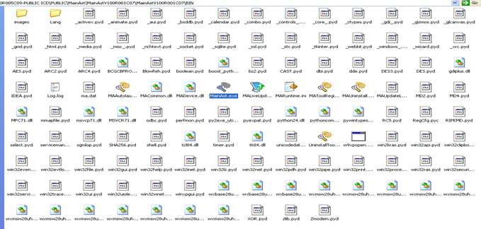
Installing MainAst Tool
Copy the MainAst folder onto the local system Windows machine
Or
Extract the MainAst software into the local machine

Slide 20
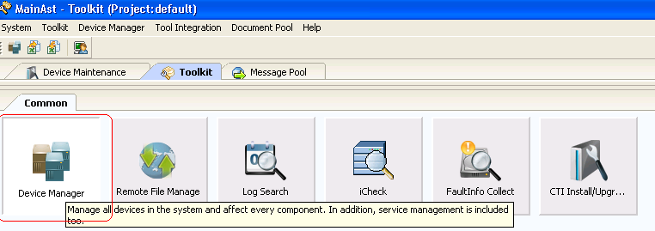
MainAst Home Page
Double click on the MainAst.exe to get to the home screen.

Slide 21
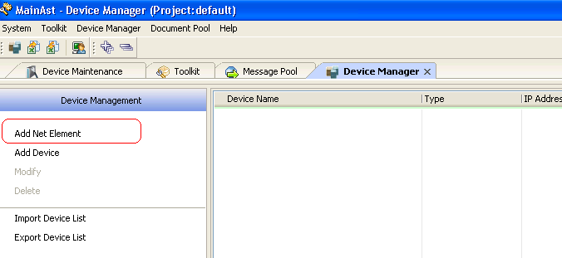
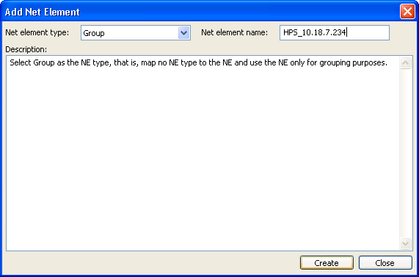
Adding Net Element in MainAst Tool
Click on the Device Manager in the homescreen
This will help creating a Net Element and then Devices in it

Slide 22
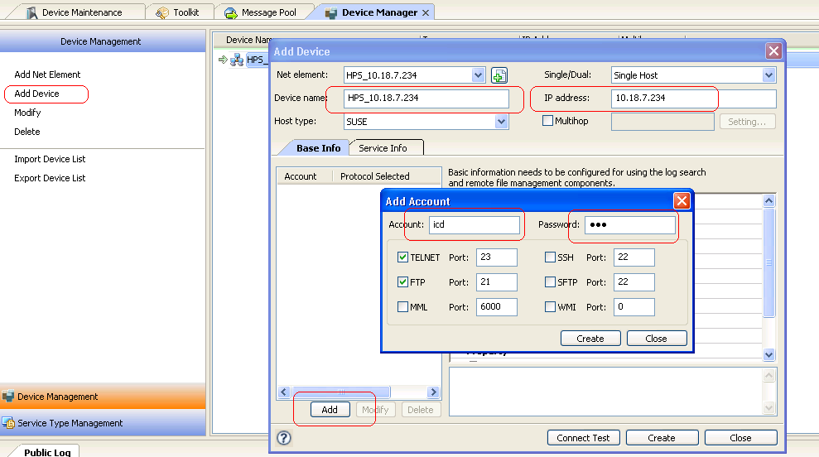
Adding Device and Associating User
Click on the Add Device as highlighted and fill in the necessary details
Add the user that was initially created in this device giving him the rights for telnet and FTP as highlighted in the picture

Slide 23
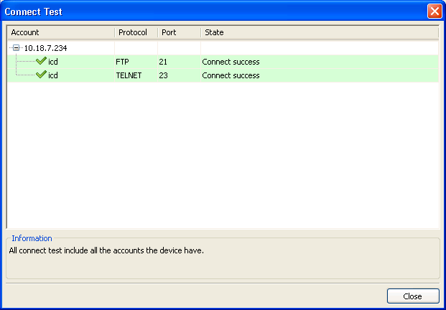
Testing the Created User for FTP & Telnet
Click on the Connection Test button to be sure that the created user who is associated with this device has the FTP and the telnet rights

Slide 24
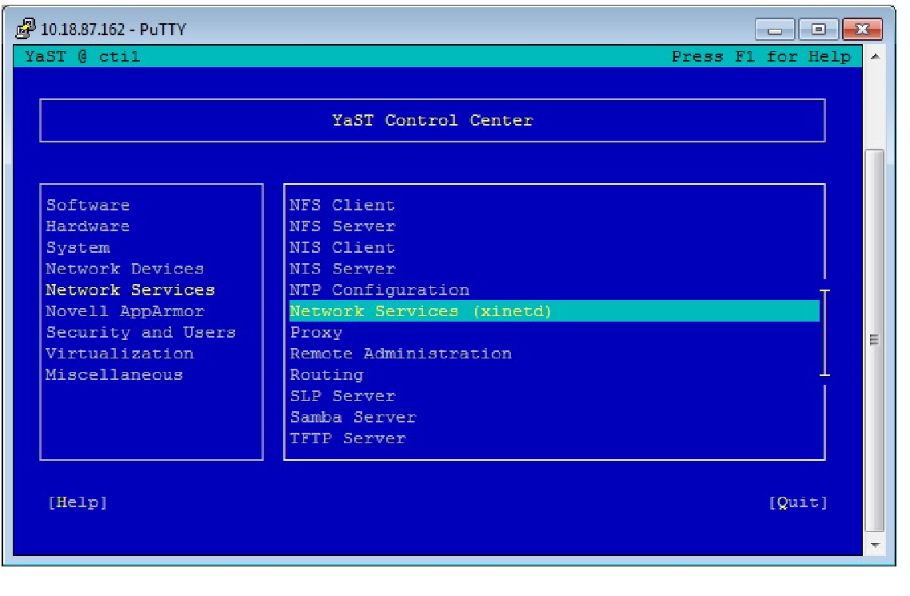
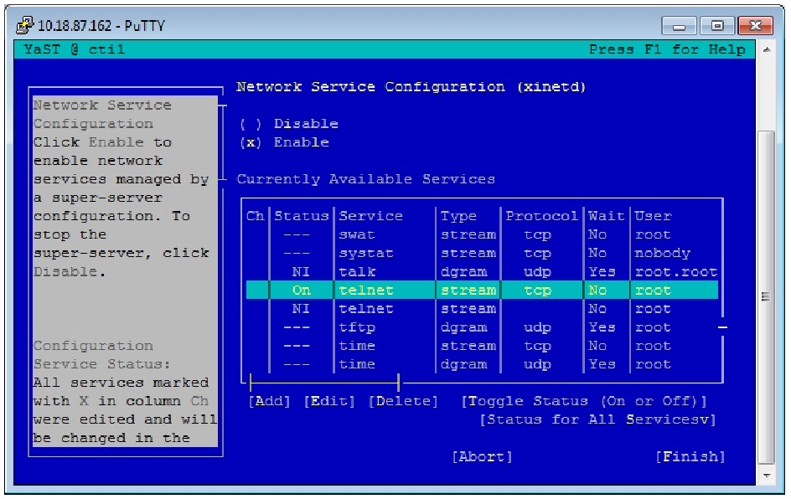
Enabling Telnet in Linux OS

Slide 25
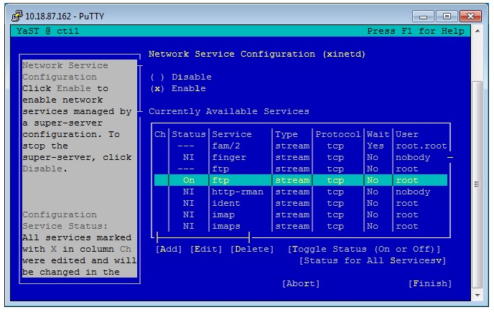
Enabling Telnet
Modify /etc/vsftpd.conf, the following line in front of "#" removed. Write_enable=YES local_enable=YES local_umask=022 ascii_upload_enable=YES ascii_download_enable=YES listen=YES set the FTP User FTP service is started, the file /etc/ftpusers in the configuration of the user is not allowed to use FTP service, such as the root user. If you need to use, the user name before the "#" removed the restrictions。
vi /etc/ftpusers #root #oracle #/etc/init.d/xinetd restart

Slide 26
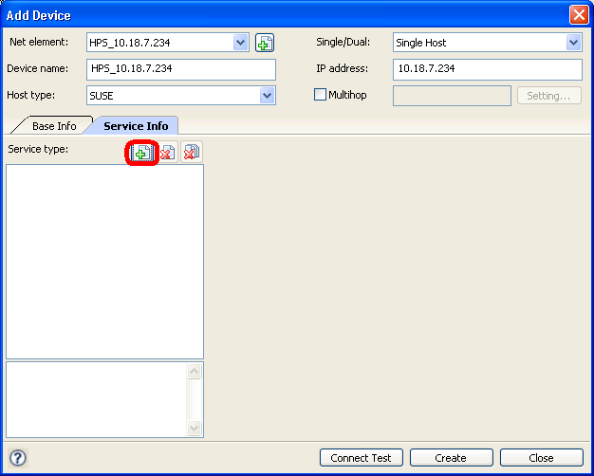
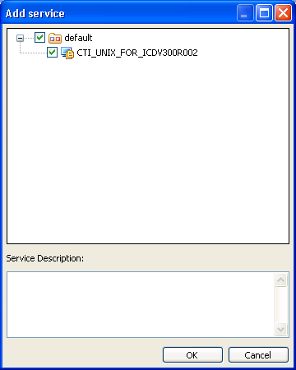
Adding Service Information
Right Click on the device created to add a service .
We need to specify to the device as in which Service are we going to use to install the CTI Platform.
We are interested in the ICD Platform (Intelligent Call distribution) for UNIX.
Select that option and then Click OK.
Do a connect test again to check the connectivity

Slide 27
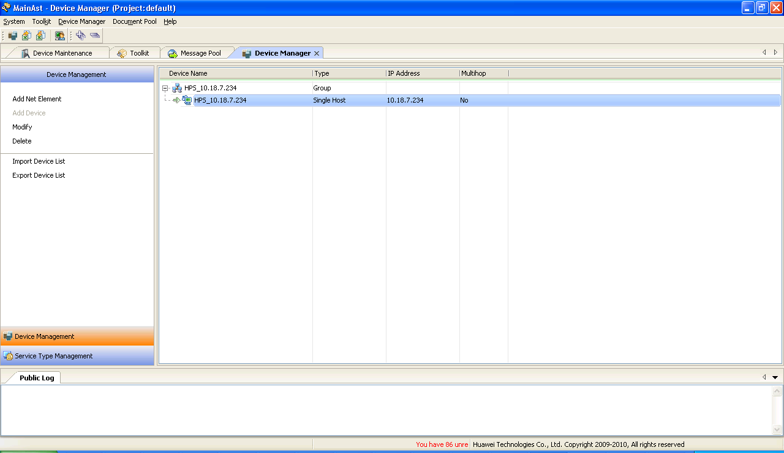
Device Manger Screen
Once the above configurations are done the Device Manager screen will look as follows
Once we have set a Net Element, which has a device on which we are ready to install the CTI Platform, we can start the installation.

Slide 28
Agenda
Huawei IPCC Network Architecture Introduction
CTI Platform Overview
WAS Overview
MainAst Tool Overview ,Installation and Configuration
CTI Platform and WAS Installation in Linux OS
CTI Upgradation
References

Slide 29
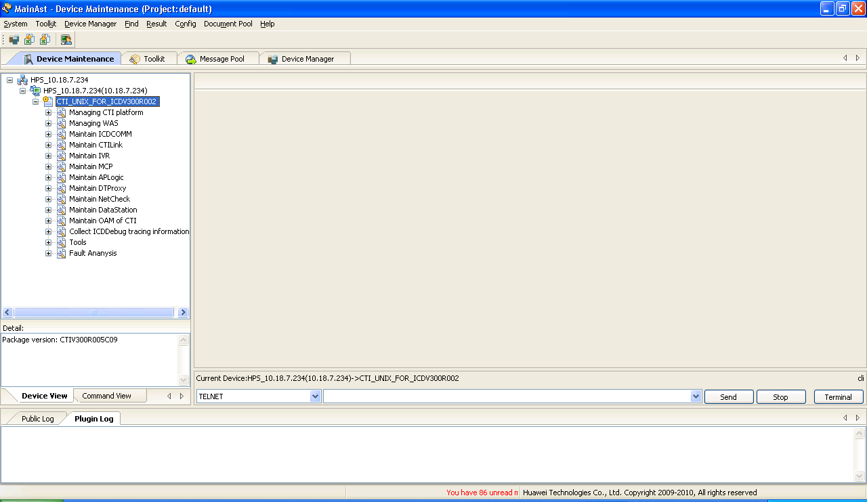
Installation of CTI & WAS in Linux OS
Step 1:
Go to the Device Maintenance, the maintenance options must be loaded as shown.

Slide 30
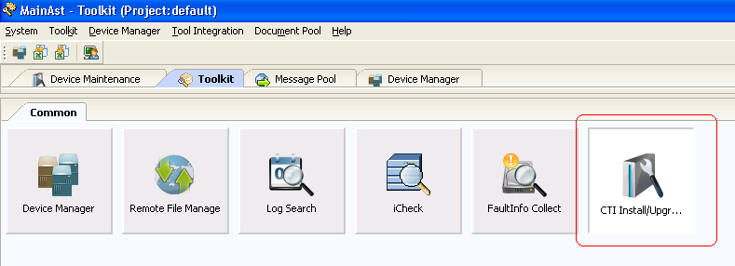
Installation of CTI & WAS in Linux OS
Step 2:
Go to the Home screen and select the CTI Install/Upgrade option
Select the CTI and the WAS installation package directories from the local machine as shown.

Slide 31
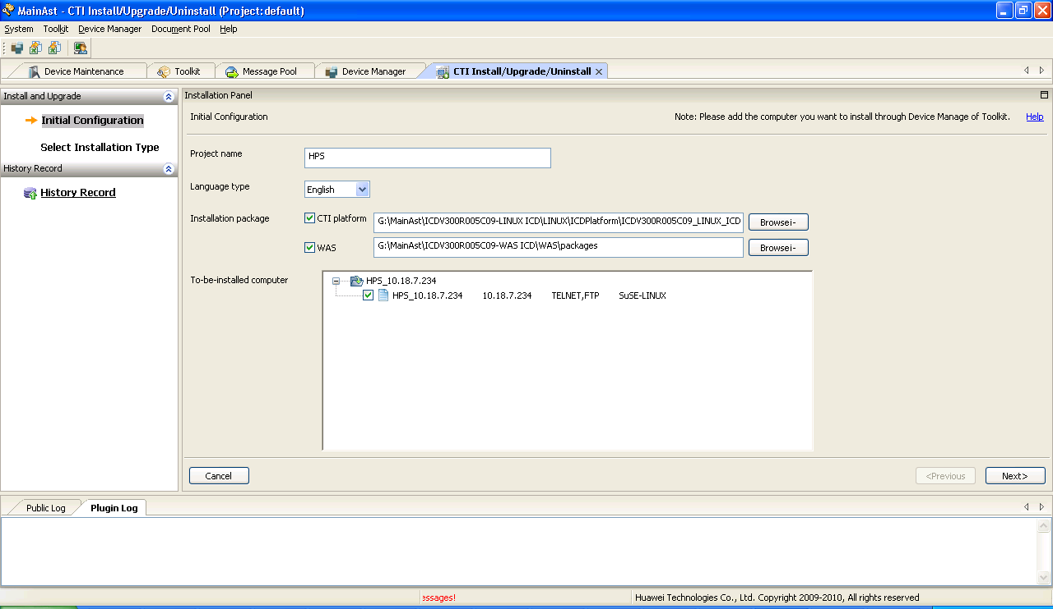
Installation of CTI & WAS in Linux OS
Step 3:
Path are as below in the CTI package
…\...\ICD\LINUX\ICDPlatform\ICDV300R005C35_LINUX_ICD.zip
…\...\ICDV300R005C35-WAS ICD\WAS\packages

Slide 32
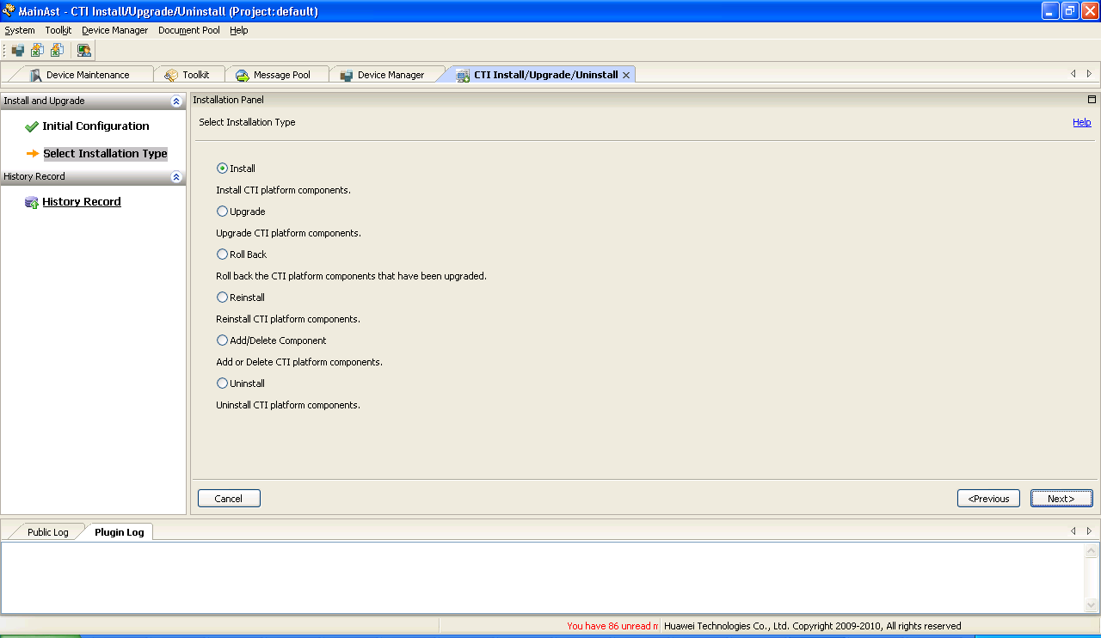
Installation of CTI & WAS in Linux OS
Step 4:
Select the option → Install

Slide 33
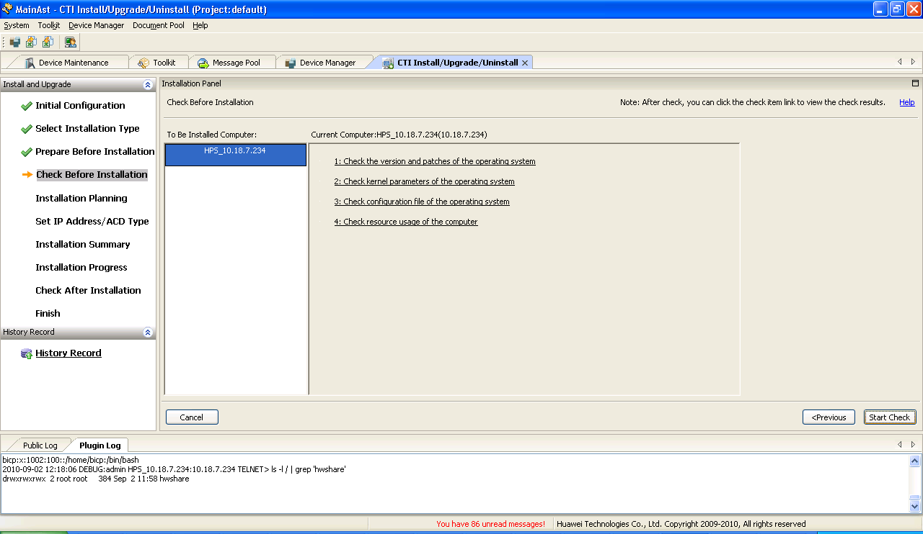
Installation of CTI & WAS in Linux OS
Step 5:
This is the screen that will prompt for the checking of the environment pre-requisites for installation.

Slide 34
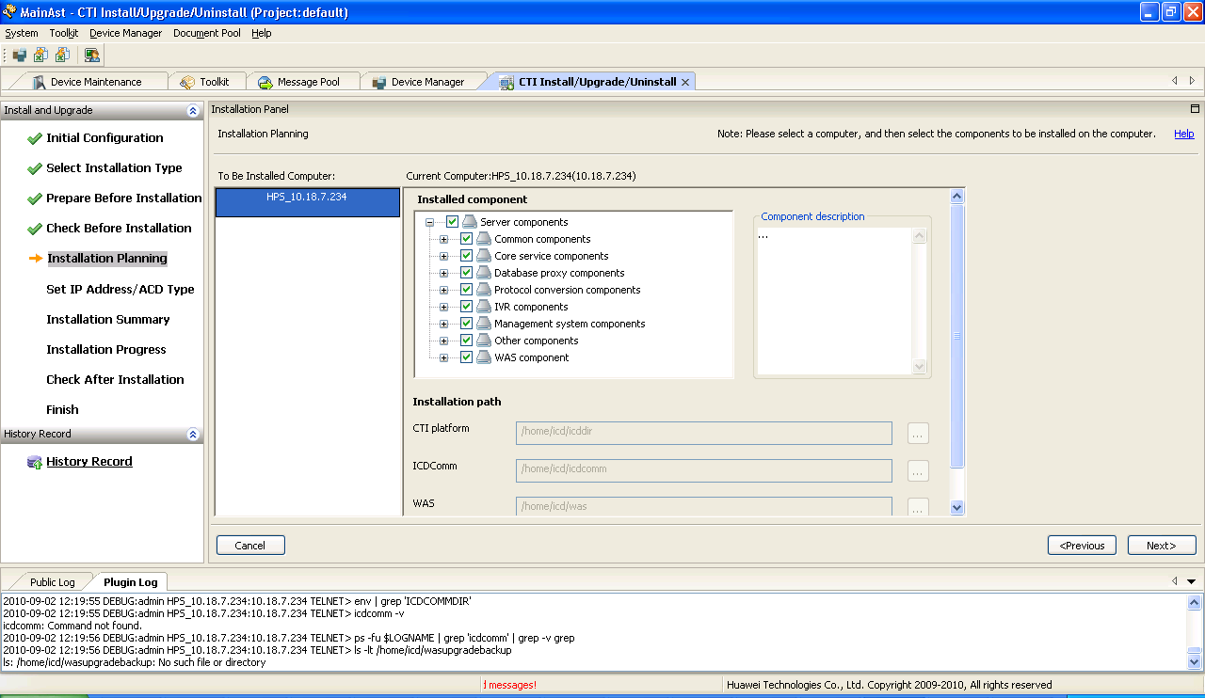
Installation of CTI & WAS in Linux OS
Step 6:
Need to specify the components that we need to be installed in the CTI Platform.

Slide 35
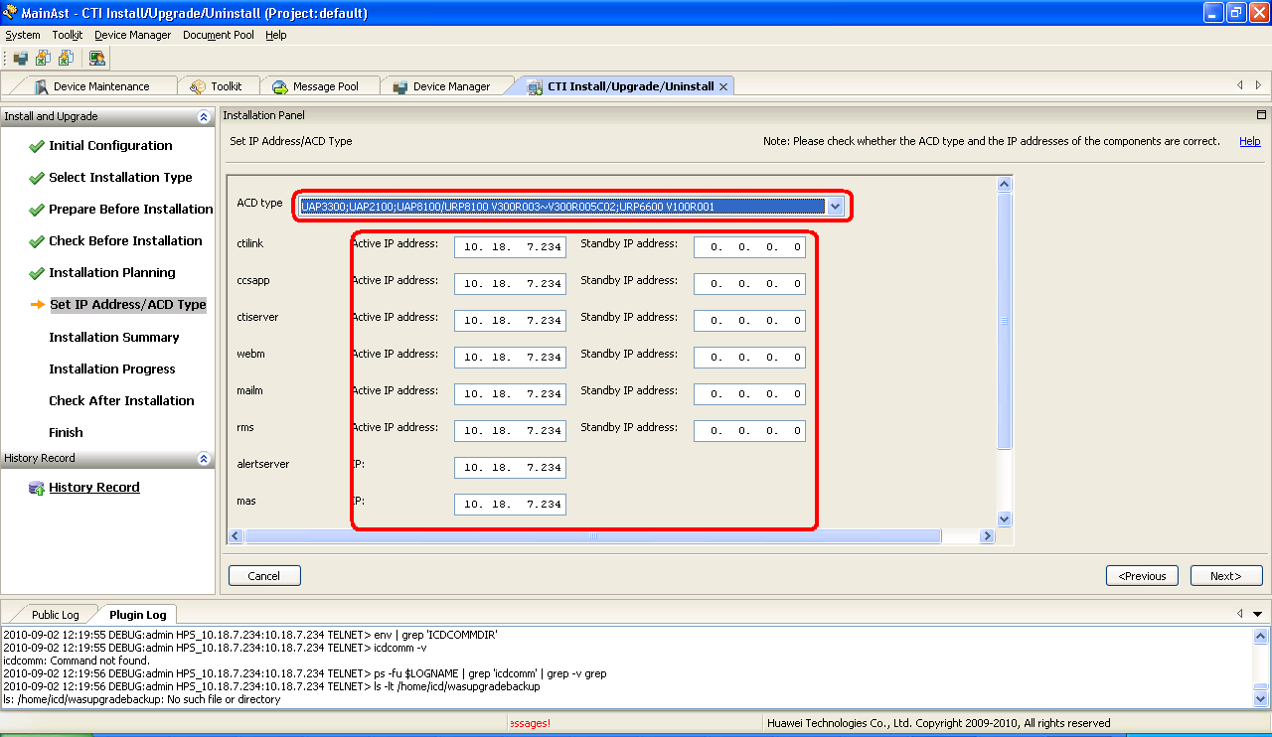
Installation of CTI & WAS in Linux OS
Step 7:
Select the right ACD Type and provide all the active and standby IP.

Slide 36
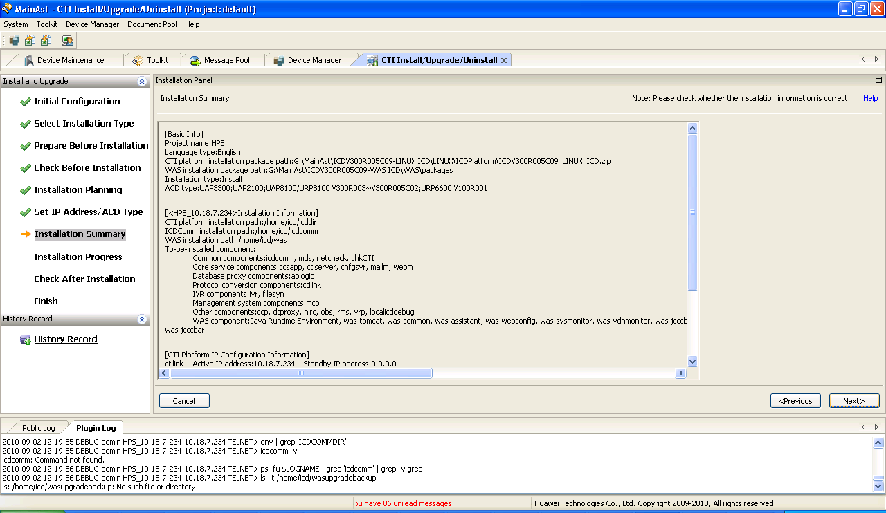
Installation of CTI & WAS in Linux OS
Step 8:
This screen will provide you the total Summary of the Installation configurations that you made.

Slide 37
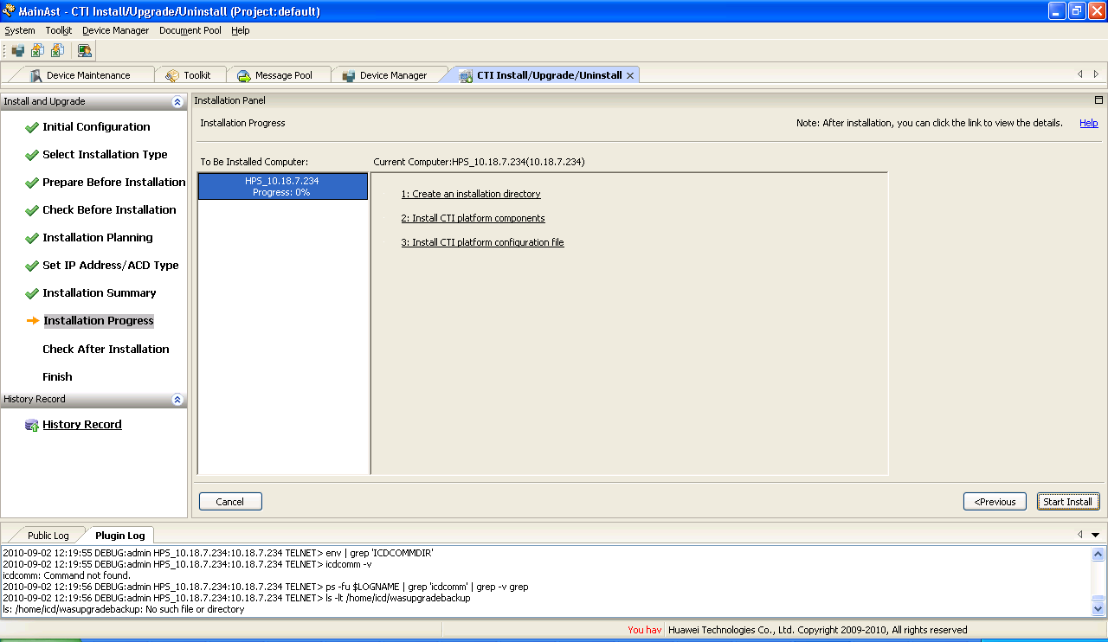
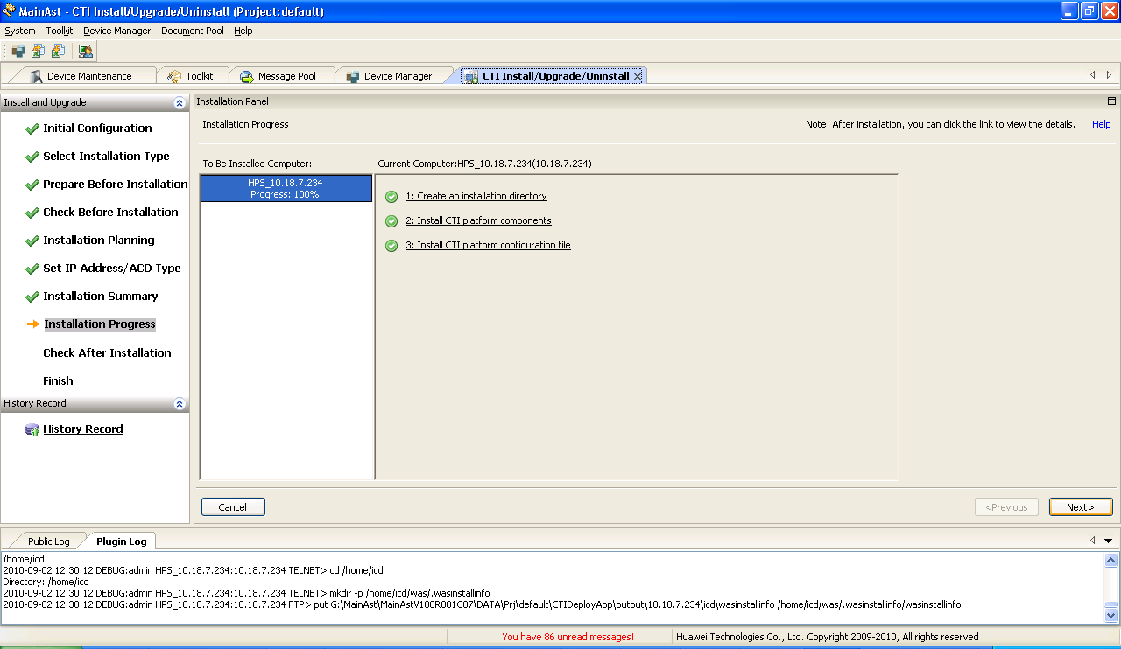
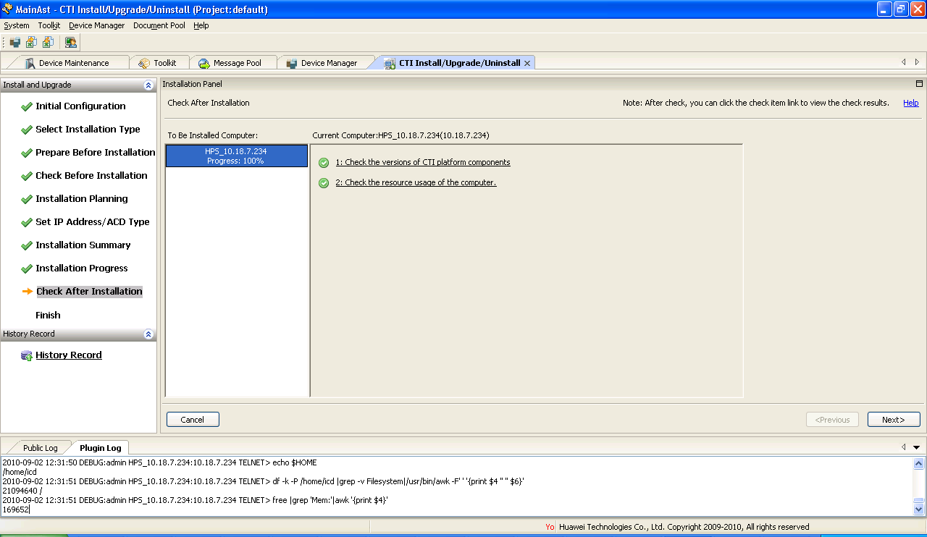
Installation of CTI & WAS in Linux OS
Step 9:
Installation basically has three steps:
Creating the installation directory
Install CTI Platform Components
Install CTI Components config file
Once the installation is complete it verifies the installation.

Slide 38
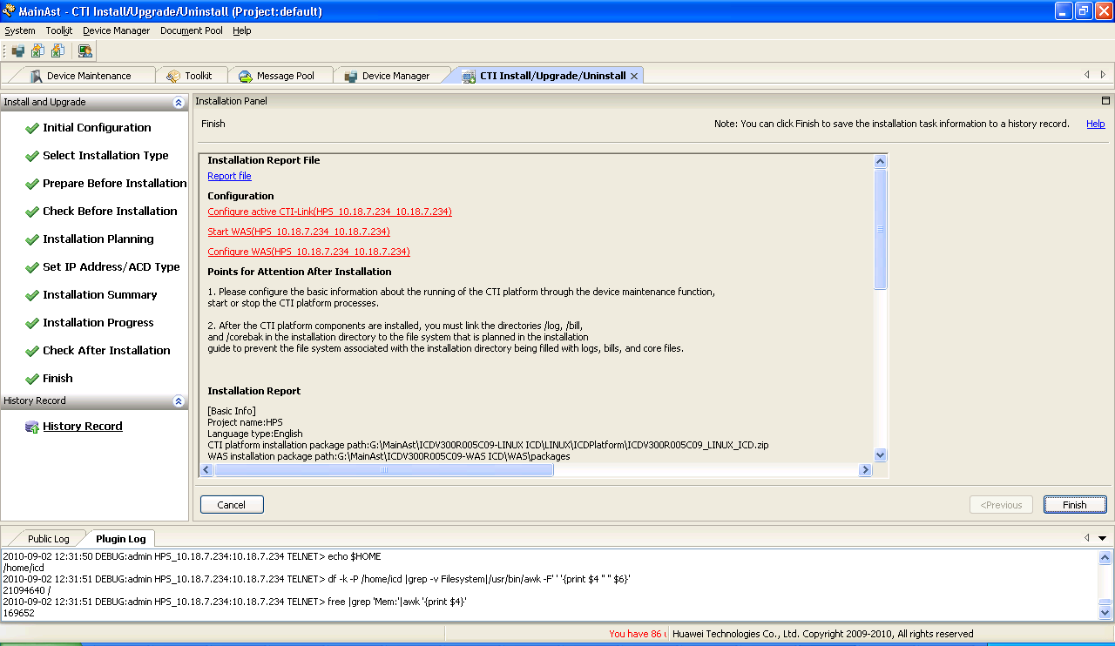
Installation of CTI & WAS in Linux OS
Step 10:
This is the final screen of the installation.
It gives the summary of the installation that was done.

Slide 39
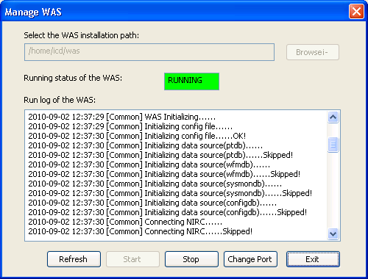
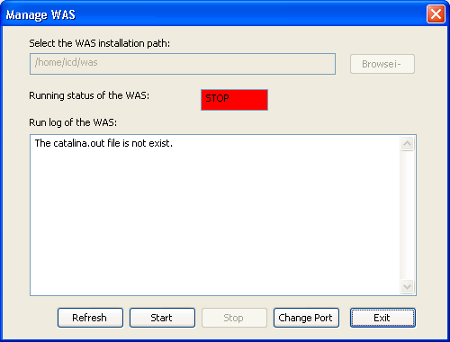
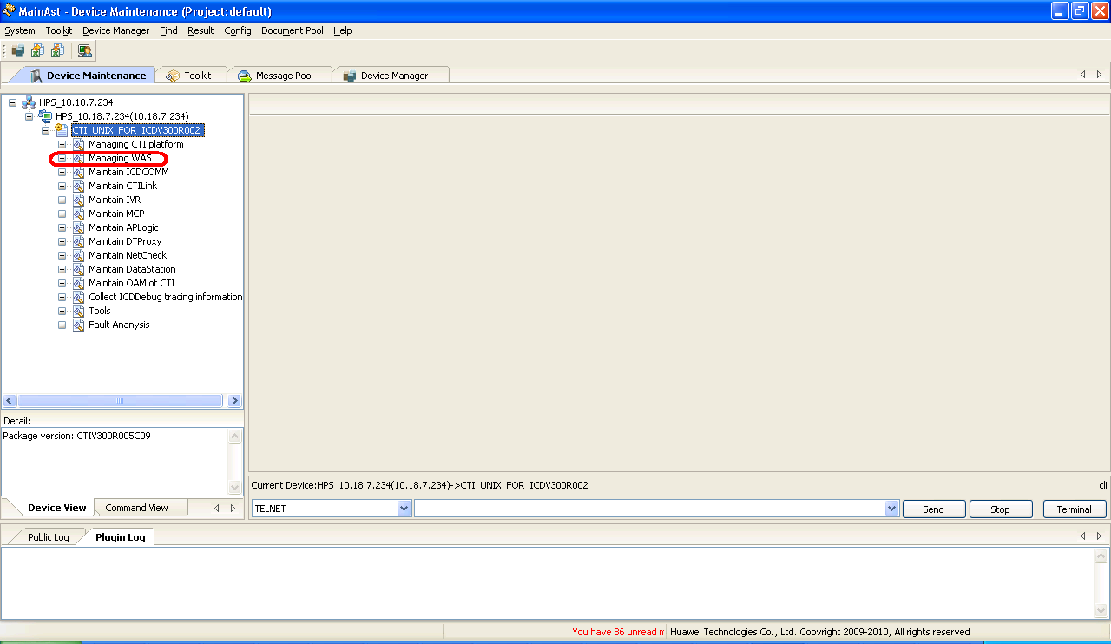
Starting of CTI & WAS Platforms
WAS started successfully.
We need to start the WAS for configuring the Call Center.
For Ex:
Add a VDN, Skill, Agents … Set OBS parameters and so on…
Once we have clicked this option you get three options to select:
Install WAS
Manage WAS
Configure WAS
Select the Manage WAS option.
Click on Start WAS, to start the Tomcat of the WAS.
Open the Device Maintenance screen in the MainAst. In the left hand side of the screen you can get an option to Managing WAS. Click this option. As shown in the image.

Slide 40
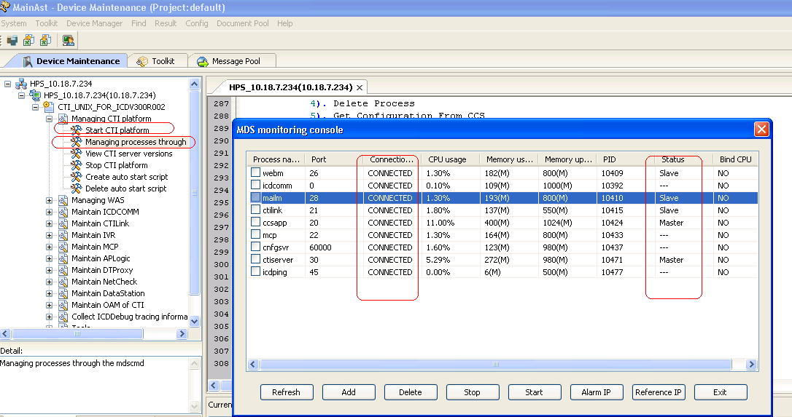
Starting CTI Platform using MainAst
All the processes must be in the CONNECTED state.
In the Device Maintenance window on the left side, you get the option to Managing CTI Platform.
Select the option Start CTI Platform as shown.
Select the option Managing processes through mdscmd to check for the connected status of the various modules in the CTI Platform.

Slide 41
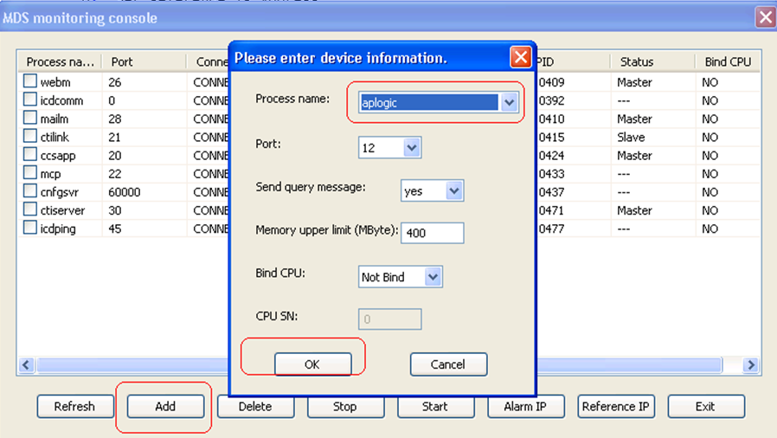
Adding Process to MDS
To add a process into the MDS, select the Add tab in the MDS window and specify the details as shown in the screen shot.

Slide 42
Agenda
Huawei IPCC Network Architecture Introduction
CTI Platform Overview
WAS Overview
MainAst Tool Overview ,Installation and Configuration
CTI Platform and WAS Installation in Linux OS
CTI Upgradation
References

Slide 43
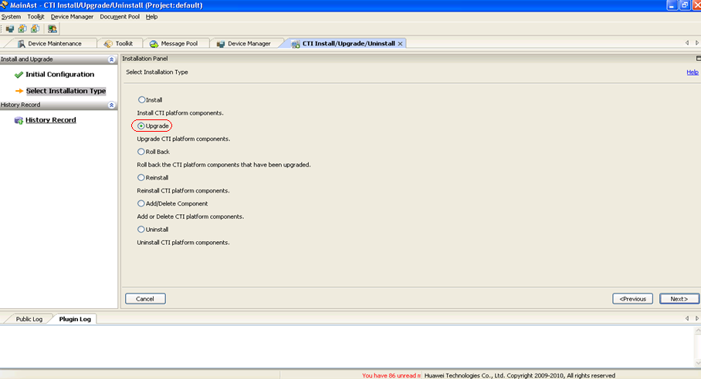
CTI Platform Upgradation
Select the option → Upgrade
And follow the steps

Slide 44
Agenda
Huawei IPCC Network Architecture Introduction
CTI Platform Overview
WAS Overview
MainAst Tool Overview, Installation and Configuration
CTI Platform and WAS Installation in Linux OS
CTI Upgradation
References

Slide 45
References
CTI Installation References:
For CTI Installation on windos, Linux OS, HP-UX & IBM-AIX &
For CTI Database installation and configuration
Refer: HUAWEI Call Center Installation Guide(V300R005C30_01).pdf
http://support.huawei.com/support/DocView.do?doc_id=SE0000535369&doc_type=ProductManual-soft
WAS Installation References:
For installation of WAS in Linux OS and Windows OS
Refer: HUAWEI Call Center WAS Installation Guide(V300R005C30_01).pdf
http://support.huawei.com/support/DocView.do?doc_id=SE0000535392&doc_type=ProductManual-soft

